Slide 1
Using the pictures above, what do you think today’s lesson is about?
people
building
homes
illegally
Discuss in small groups

Slide 2
people
building
homes
illegally
Illegal Israeli settlements in the West Bank
People building homes illegally

Slide 3
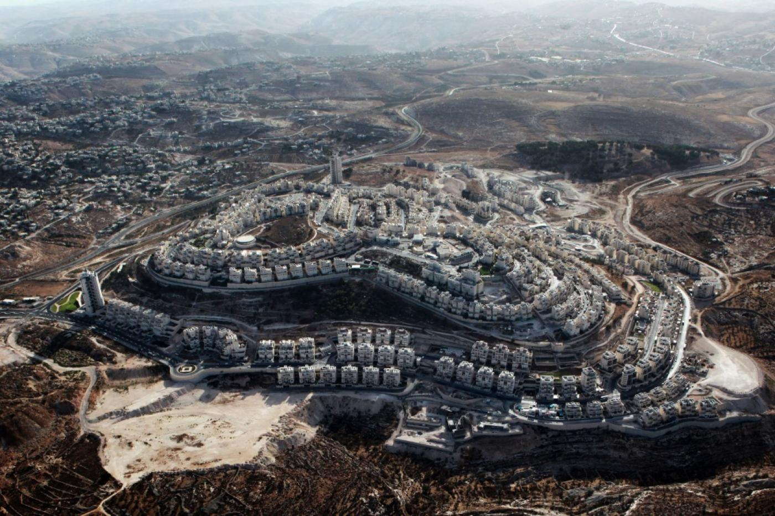
What is the impact of illegal Israeli settlements in the West Bank?
Lesson 16

Slide 4
Learning objectives
By the end of this lesson, you should be able to:
Describe what an illegal Israeli settlement is
Explain why this is illegal under international law
Discuss the impact of this on Palestinians in the West Bank

Slide 5
16a. Keywords activity In small groups, cut out these cards and match up the keywords with the definitions, like this:
Illegal Israeli settlement
____________________
Laws on the relationships between countries
Settlements
____________________
The area of Palestine-Israel which came under Jordanian control as a consequence of the Arab-Israeli War of 1948
Fourth Geneva Convention
___________________
The establishment of an Israeli community on Palestinian land, which violates the Fourth Geneva Convention
International law
___________________
Someone with Israeli citizenship who makes a home on Palestinian land
Israeli settler
___________________
The establishment of small communities
West Bank
__________________
An agreement about how civilians should be treated in war zones, from 1950
Extension question: which of these keywords have you come across before?

Slide 6
Next, cut along the brown line and stick the matching keywords and definitions into your glossary together:
The establishment of small communities
Settlements
The area of Palestine-Israel which came under Jordanian control as a consequence of the Arab-Israeli War of 1948
West Bank
Laws on the relationships between countries
Israeli settler
___________________
The establishment of small communities
International law
An agreement about how civilians should be treated in war zones, from 1950
Fourth Geneva Convention
The establishment of an Israeli community on Palestinian land, which violates the Fourth Geneva Convention
Someone with Israeli citizenship who makes a home on Palestinian land
Illegal Israeli settlement
Israeli settler

Slide 7
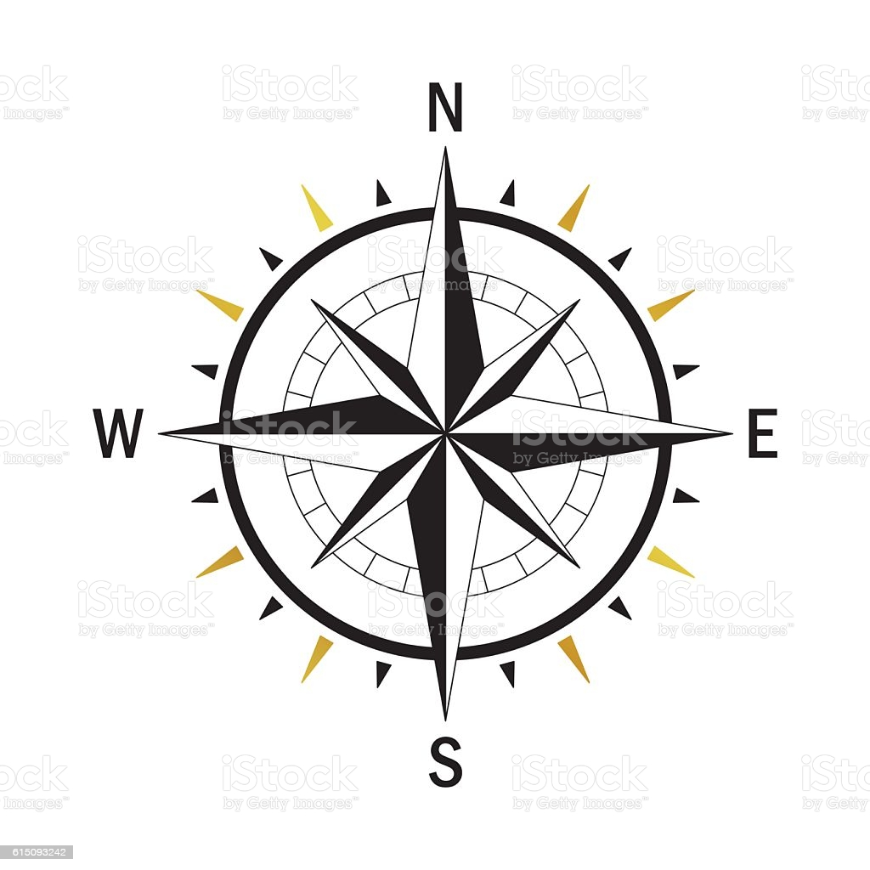
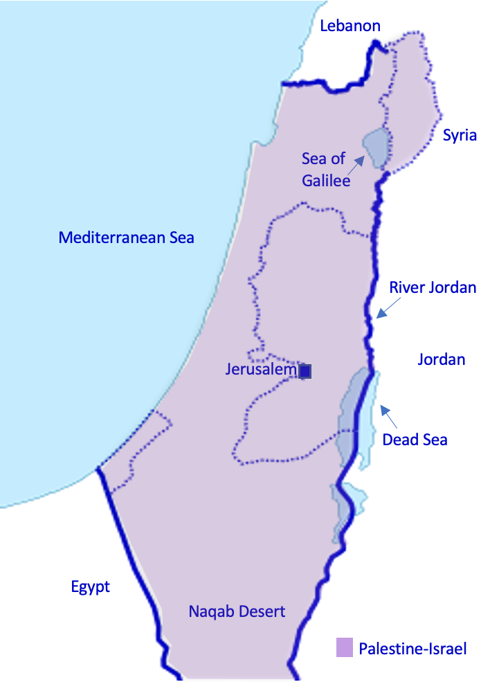
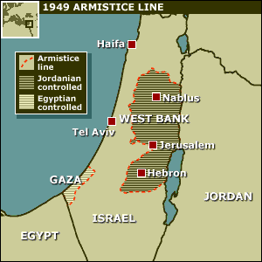
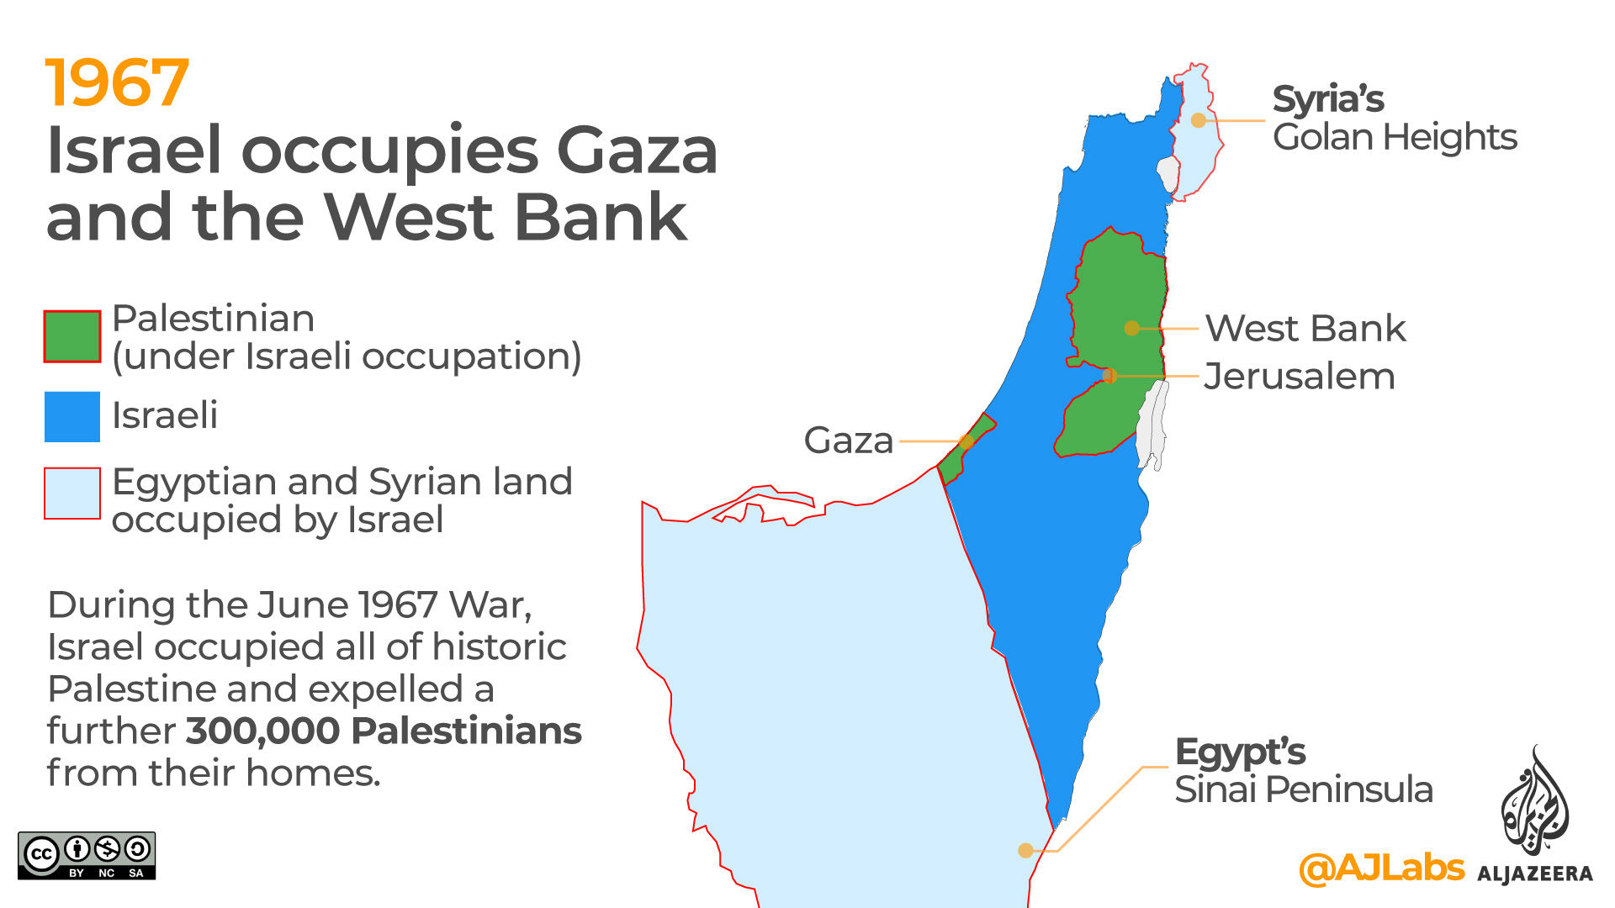
Recap: in pairs
Extension question: why is it called the West Bank? Hint:
Where is the West Bank on this map of Palestine-Israel from Lesson 1?
What happened to the West Bank in 1948 and 1967?
WEST
Under Jordanian control,
1949-1967
Israel occupied the West Bank in 1967

Slide 8
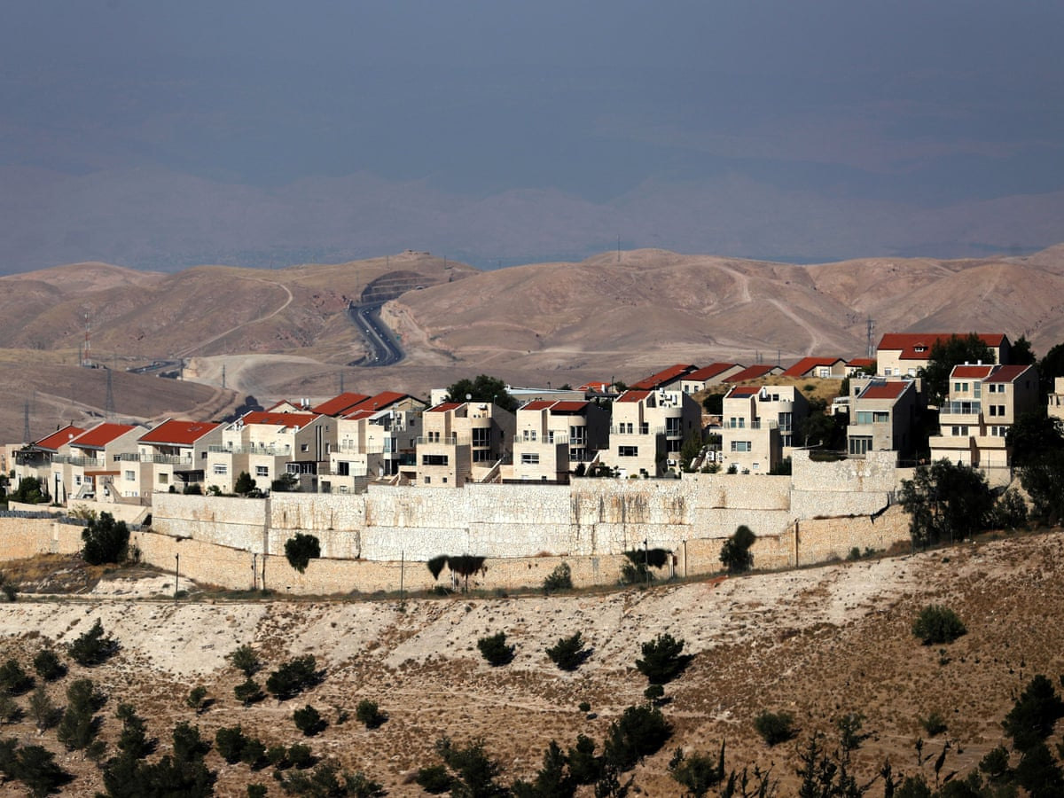
16b. Illegal Israeli settlements in the West Bank
What is an illegal Israeli settlement?
The establishment of an Israeli community on Palestinian land. This violates international law
How many are there?
In May 2021 there were 250 settlements across the West Bank and East Jerusalem, home to between 600,000 and 750,000 Israeli settlers
Working independently, read the information above and write down two or three things you want to know about illegal Israeli settlements. Then stick this sheet into your book
_______________________________________
_______________________________________
_______________________________________

Slide 9
What do you want to know about illegal Israeli settlements?

Slide 10
Why do people choose to settle in the occupied West Bank?
People choose to settle in the occupied West Bank for a number of reasons. Create a spider diagram grouping the following into political, economic, social and religious motives:
Zionists believe that all of historic Palestine-Israel should be a Jewish state
Houses are cheaper in the occupied West Bank than in Israel because they are subsidised by the Israeli government. This means that settlers can afford bigger homes
Some religious Jews believe that God gave Palestine-Israel to the Jews
The cost of living is lower in the occupied West Bank than in Israel, so settlers have a higher quality of life for cheaper
Some religious Jews believe that by settling in the West Bank, they are serving God’s will and will bring about the coming of the Messiah
Extension question: Are any of these reasons linked? How?

Slide 11
Why are settlements illegal?
In 1967 Israel occupied the West Bank (it invaded and took control)
According to international humanitarian law, it is illegal for a country to move its population into a territory it has occupied
This means that it is illegal for Israel to move its population into the West Bank because the West Bank is occupied territory
This law is set out in Article 49 of the Fourth Geneva Convention
“The Occupying Power shall not deport or transfer parts of its own civilian population into the territory it occupies”
Article 49 of the Fourth Geneva Convention
In your book write two sentences explaining why Israeli settlements in the West Bank are illegal under international law

Slide 12
What does the UN say about Israeli settlements?
Recap: what is the UN?
An international organisation established after WW2 to replace the League of Nations and prevent another world war
In 1967, the UN passed Resolution 237. This condemned Israeli settlements in the occupied West Bank
Since then, many UN Resolutions have condemned Israeli settlements: Resolution 237 in 1967, Resolution 252 in 1968, Resolution 267 in 1969, Resolution 271 in 1969, Resolution 298 in 1971, Resolution 465 in 1980 and Resolution 2334 in 2016
Resolution 2334 of 2016 says that Israeli settlements on occupied Palestinian land have ‘no legal validity… a flagrant violation under international law’
UN Resolutions condemning Israeli settlements on Palestinian land:
UN Resolution | Year
No. 237
No. 252
No. 267
No. 271
No. 298
No. 465
No. 2334
1967
1968
1969
1969
1971
1980
Copy and fill out this table in your book:
2016

Slide 13
16c. Fill in the blanks using these words:
2021
Palestinian
2334
condemned
Israeli
population
750,000
250
international law
2016
1967
Illegal Israeli settlements in the West Bank
A settlement is the establishment of a small community. An illegal _______ settlement is the establishment of an Israeli community on occupied _________ land, such as the West Bank.
In ____, Israel occupied the West Bank: it invaded and took control. Under ______________, it is illegal for a country to move its ________ into a territory it has occupied. This means that it is illegal for Israel to move its population into the West Bank. The UN has __________ Israel’s illegal settlements in the West Bank many times, and most recently in Resolution ____ in ____.
By May ____ there were _____ settlements across the West Bank and East Jerusalem, home to up to ________ settlers.
Exchange your completed worksheet with the person sitting next to you

Slide 14
What is the impact of illegal Israeli settlements on Palestinians in the West Bank?

Slide 15
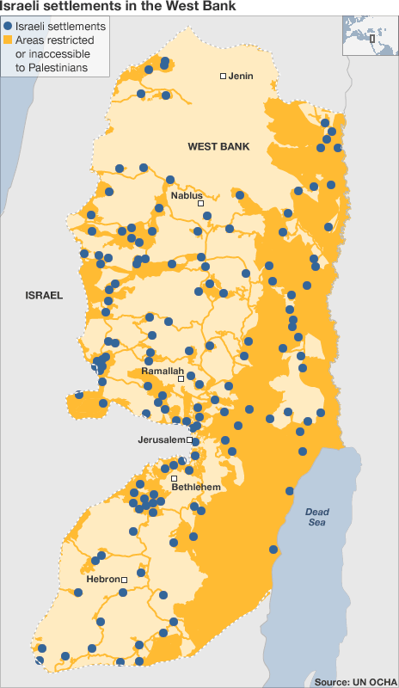
1 of 250 illegal Israeli settlements across the West Bank
Small group discussion:
What impact do you think the building of this settlement might have on Palestinians living locally?

Slide 16
Some of the impacts on Palestinians
Loss of land
Home demolitions. Since 2004, 1000 Palestinian homes have been destroyed by Israel to make way for settlements
Settler violence: settlers often attack Palestinians. In the first 6 months of 2021, there were 273 incidents of this
Breaking up the land of a future Palestinian state. What would a future Palestine look like now? Where would the border be?
Roads. New settler-only roads have been built in the West Bank. Palestinians are not allowed to use these; they have to use older, longer routes instead
Is this fair? Discuss this with the person sitting next to you and write down your conclusion
Next, join up with another pair and share your answers. Do you think similarly or differently? Why?

Slide 17
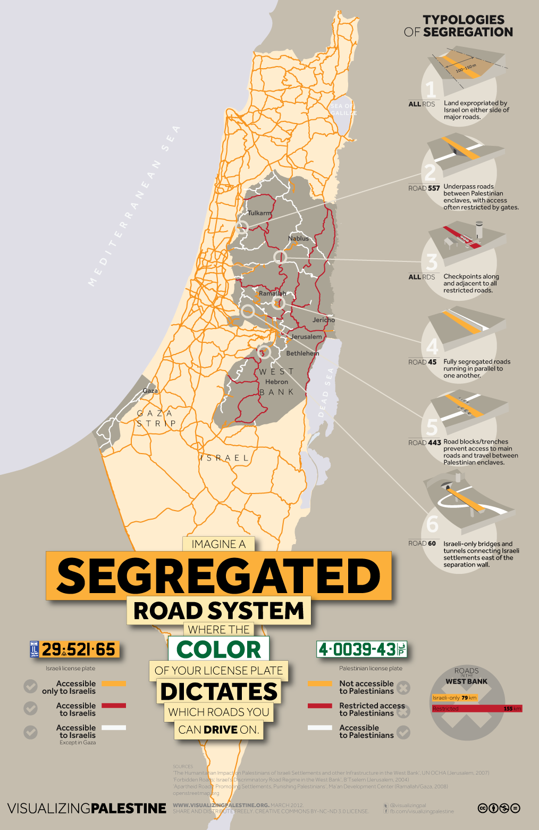
What does this infographic tell you about the impact of illegal Israeli settlements on Palestinian life in the West Bank?

Slide 18
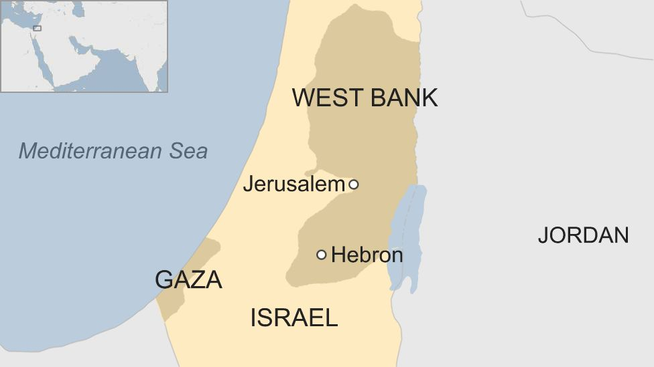
Case study: Hebron
Hebron is a city in the south of the West Bank
It is home to over 200,000 Palestinians, 600 illegal Israeli settlers and 2000 Israeli soldiers!
The illegal Israeli settlements make life very difficult for Palestinians in Hebron

Slide 19
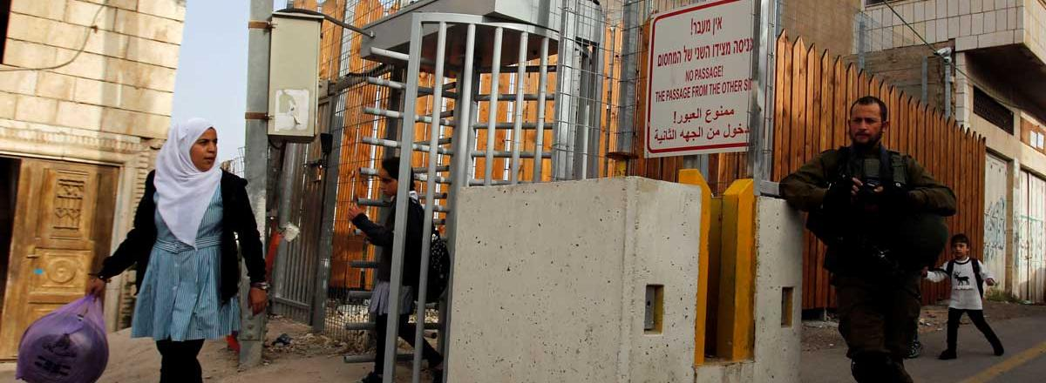
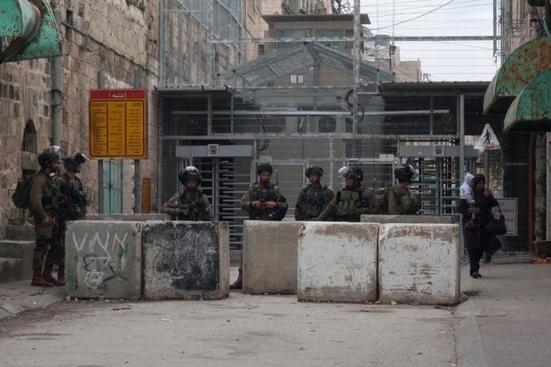
Life in Hebron
Checkpoints: barriers set up by Israel to control and restrict Palestinian movement. In 2021 there were nearly 600 checkpoints across the West Bank
(add this to your glossary)
What is a checkpoint?
Have you ever passed through a checkpoint?
In the city of Hebron, there are 86 checkpoints, roadblocks or physical obstructions controlled by Israeli soldiers
They divide Hebron into Israeli and Palestinian areas
This severely restricts Palestinian freedom of movement

Slide 20
Life in Hebron: Video
https://www.youtube.com/watch?v=cYSTf5rWyu4
Watch this video and answer these questions in your book:
1.In the past 10 years, how many Israelis have been killed by Palestinians in the West Bank?
2.In the past 10 years, how many Palestinians have been killed by Israelis in the West Bank?
60
Over 400
Hebron is split into two areas:
-H1, the Palestinian area
-H2, the Israeli area

Slide 21
16d. Debate You are now going to be assigned a partner. You and your partner are either ‘support’ or ‘opposition’ to illegal Israeli settlements. You can spend a few minutes preparing your argument Then you will join with another pair and have a debate about this What can you use from this lesson and previous lessons to support your argument?
Occupation: invasion and temporary control over a territory
Support for Israeli settlements:
Ideas:
-Israel occupied the West Bank in 1967, so Israeli citizens should be able to live here now
-Houses are cheaper in the West Bank so Israelis can afford bigger houses
-The cost of living is lower in the West Bank, so Israelis can enjoy a higher quality of life for cheaper
Opposition to Israeli settlements:
Ideas:
-‘Occupation’ is meant to be temporary. Israel should now give the West Bank back to the Palestinians
-Palestinians have lived in the West Bank for centuries. It is their ancestral land
-Israeli settlements are illegal under international law. They violate Article 49 of the Fourth Geneva Convention

Slide 22
How did you find this debate?
Was this debate difficult?
Did both sides have anything in common?

Slide 23
Food for thought
In 2021, Ben and Jerry’s announced that it would not renew its licensing agreement in the occupied West Bank due to Israel’s illegal settlements on Palestinian land
Co-founders Ben and Jerry explained that settlements ‘violate the basic human rights of the Palestinian people’
Should more companies do this?

Slide 24
Homework
Answer the question below in your book.
You can use your notes from today’s lesson to support your argument
Should illegal Israeli settlement building in the West Bank continue? Why or why not?

Slide 25
Plenary Answer this question with the person next to you: what 3 things have you learnt today about illegal Israeli settlements in the West Bank?

